Slide 1
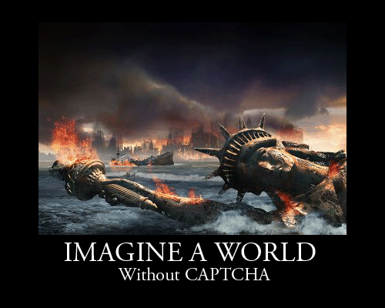
CAPTCHAs: Breaking & Building
A Presentation of Academic Research
r3dfish & dr_dave

Slide 2
A little humor…

Slide 3
A little humor…

Slide 4
dr_dave
BS in Computer Information Systems @ ASU
MS in Computer Science @ NJIT
MS in Information Technology @ Rutgers
5th year PhD Candidate in IS/IT @ Rutgers University
Work on CAPTCHA Attacks and Designs
Enjoy all types of information security research

Slide 5
r3dfish
BS in Computer Information Systems @ ASU
DefCon 17 speech “Hadoop: Apache’s open source implementation of Google’s Map/Reduce framework”
HackedExistence.com
Youtube.com/HackedExistence

Slide 6
CAPTCHA
Completely Automated Public Turing test to tell Computers and Humans Apart
Human or Bot?
Prevents abuse by bots/blackhats
Protects scarce resources

Slide 7
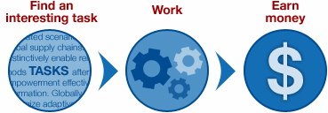
Why Use CAPTCHAs?
Challenges faced by web service provider
Cost of security vs. cost of operation of service
Tolerance level for bot activity?
Attackers can pay humans to solve challenges
CAPTCHA mitigates attacks from bots by creating a challenge that uses a “hard” AI problem
An effective CAPTCHA costs money to break

Slide 8
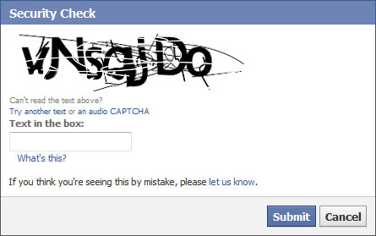
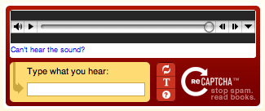
Three Major Types
Text Based
Image Based
Audio Based

Slide 9
Design Criteria for Evaluation
Usability
Can the users understand the challenge?
Can the users solve it quickly?
Can impaired users solve it? (blind, deaf, etc.)
Scalability
Accommodate a large numbers of users?
Can the challenge be generated without humans?
Robustness
Resiliency to attacks?
Real Time Content input for challenge generation

Slide 10
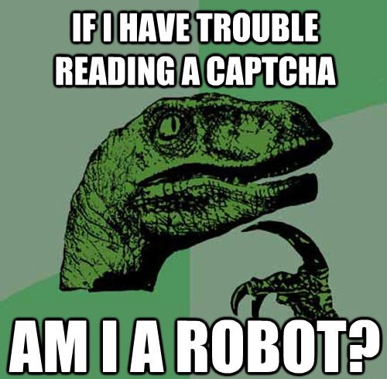
Breaking CAPTCHAs

Slide 11
Common CAPTCHA Breaking Techniques
Optical Character Recognition (OCR)
Segmentation
Filtration
Computer Vision Algorithms
Object recognition
Scene tagging/Image annotation
Machine Learning Models (Support Vector Machines etc.)
Deep Learning Models (Neural Networks)
Speech to Text (audio CAPTCHA translation)
… and many more novel methods specific to certain styles of CAPTCHAs

Slide 12
Automated Breaking Tools
Standalone automated breakers are great for non changing CAPTCHA services
Can now also send difficult challenges to a human solving service (e.g. DeathByCAPTCHA)
Can share custom algorithms for defeated unique CAPTCHA challenges with community
Examples:
GSA CAPTCHA Breaker ($147)
DeCaptcher ($2 per 1,000 images)
CAPTCHA Sniper ($97)

Slide 13
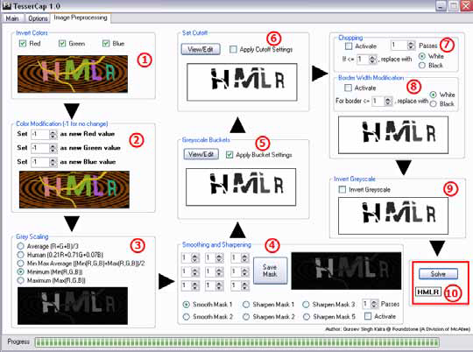
Example of CAPTCHA Breaker

Slide 14
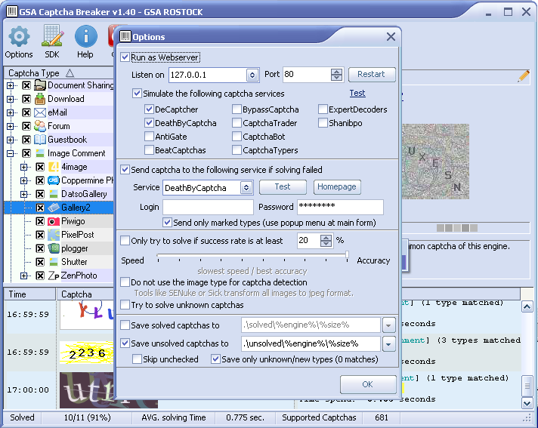
Example of CAPTCHA Breaker

Slide 15
Image Annotation Services
Alchemy, NeuralTalk etc.

Slide 16
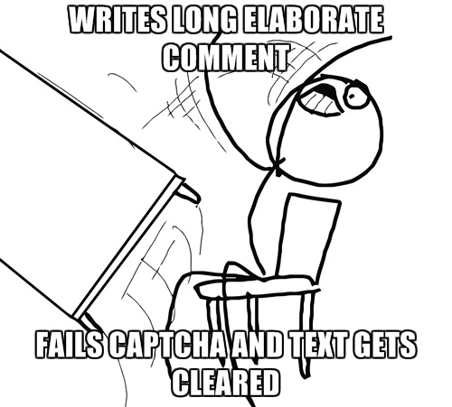
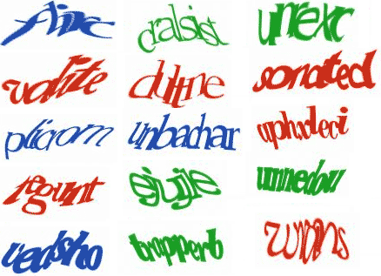
Text CAPTCHAs are Dead!
Deep Learning models and other novel methods can defeat text CAPTCHAs easily
More robust text challenges impact usability

Slide 17
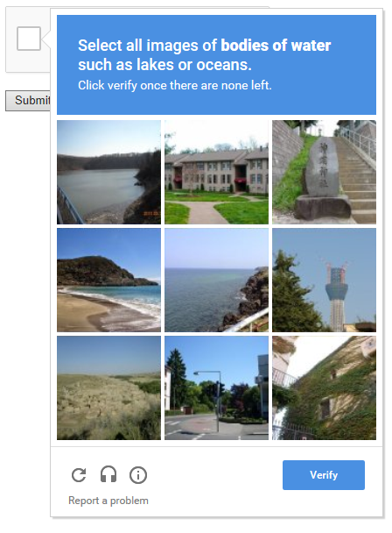
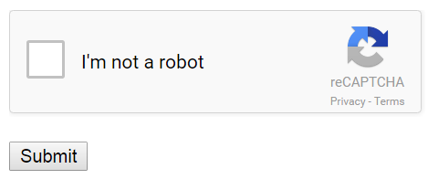
Current Best-Of Breed CAPTCHAs
Behavior Based Models
Risk Based Models
Multi-layered Challenges

Slide 18
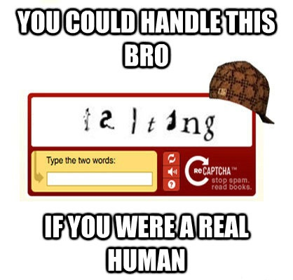
DEMO
http://rbscaptchalab.com

Slide 19
Our “Hard AI” Problem
Human Emotion Recognition
Contextual Information contained in image
Is it impossible for a computer to perform this task?
No, but it is not a trivial challenge
Success is highly dependent upon specific criteria
Video/Image properties, composition etc.
Tolerances of detection algorithms

Slide 20
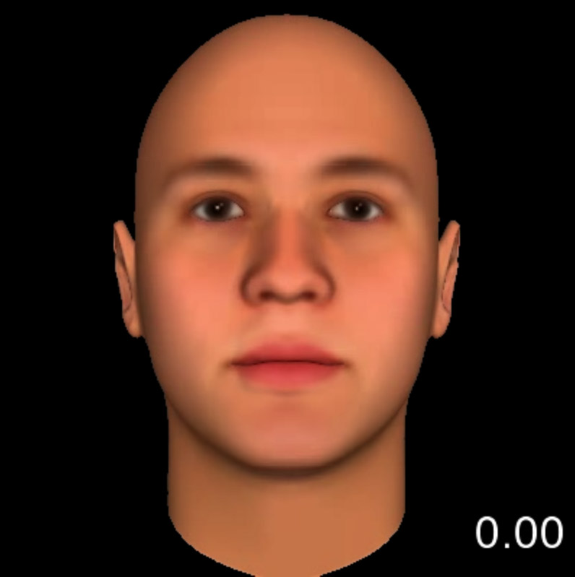
Facial Cues for Measurement

Slide 21
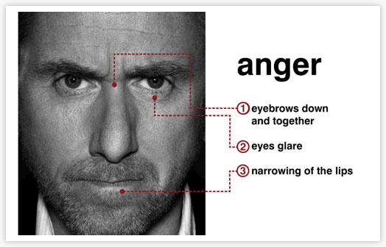
Facial Cues for Measurement

Slide 22
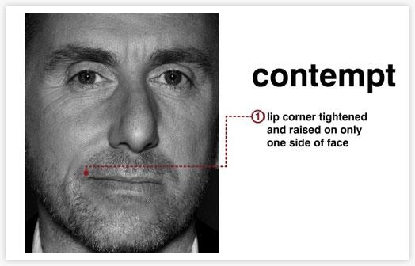
Facial Cues for Measurement

Slide 23
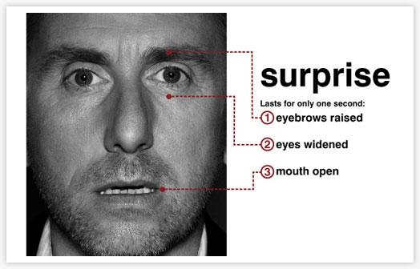
Facial Cues for Measurement

Slide 24
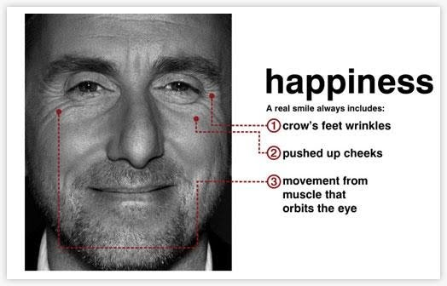
Facial Cues for Measurement

Slide 25
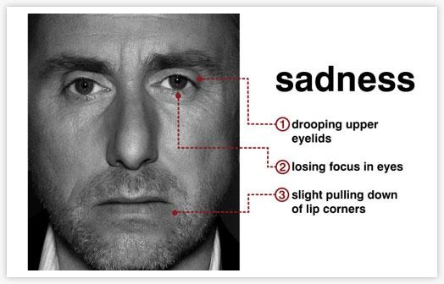
Facial Cues for Measurement

Slide 26
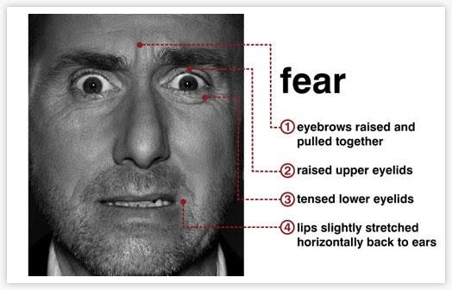
Facial Cues for Measurement

Slide 27
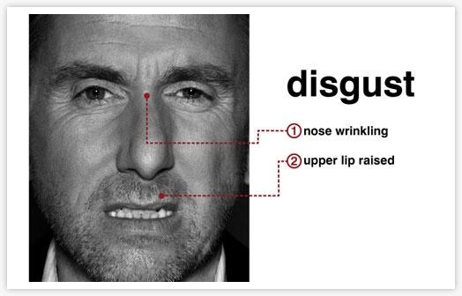
Facial Cues for Measurement

Slide 28
Generating a Sample CAPTCHA Challenge
Use image scraper to gather images of faces expressing one or more of the 8 emotions detectable by Emotion API
Use Emotion API to recognize faces and emotions expressed
Save this information into database
Perform image distortions on images until RIS and Emotion API return “garbage”/ 0 results
Ask user to demonstrate humanity by matching an equivalent emoticon to the emotion being expressed by a face in the CAPTCHA challenge
Evaluate correctness of response and Pass or Fail

Slide 29
Application Design Flow
Open Source Python Scraper
Uses Google’s Image Search
Microsoft’s Project Oxford Emotion API
GIMP Image Filters – ScriptFu
Built on Django

Slide 30
Python Scraper

Slide 31
Microsoft Cognitive Services

Slide 32
MS Emotion API
Part of MS Cognitive Services – a REST API
Algorithm that detects 8 different emotions in human faces and provides a bounding box for facial recognition

Slide 33
MS Emotion API
Works for up to 64 people in a single image
Image formats: JPEG, PNG, BMP, GIF(the first frame)
Accepts images < 4MB.
The detectable face size is between 36x36 and 4096x4096 pixels
The faces are ranked by face rectangle size in descending order
Frontal and near-frontal faces = best results

Slide 35
Creating Image Security
Relies on MS Emotion API to detect emotions of faces in images initially
Images are then modified and presented to the user
Modified image must no longer be recognizable by the Emotion API
User is asked to provide emotion as challenge response

Slide 36
GIMP Filter Example

Slide 37
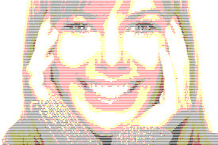
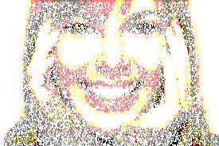
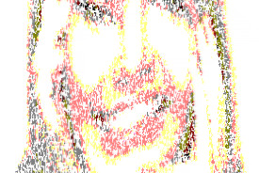
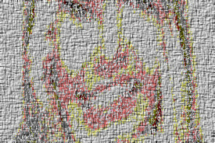
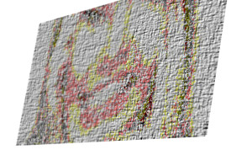
Example of Distortion Chain
Original Image
Information Removal
Image Destruction
i(1)
i(2)
i(3)
“Garbage” Information Added
Perspective Change
i(4)
i(5)
Warping/Distortion
Final Image

Slide 38
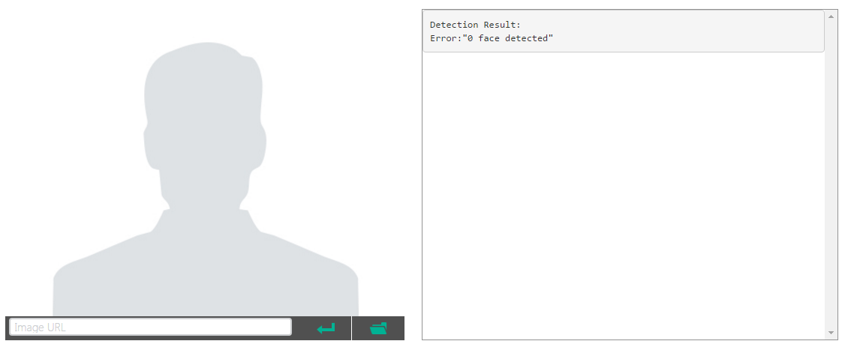
Stopping Emotion API
Error: “0 face detected” is our success case, when the Emotion API can no longer identify the face or the emotion

Slide 39
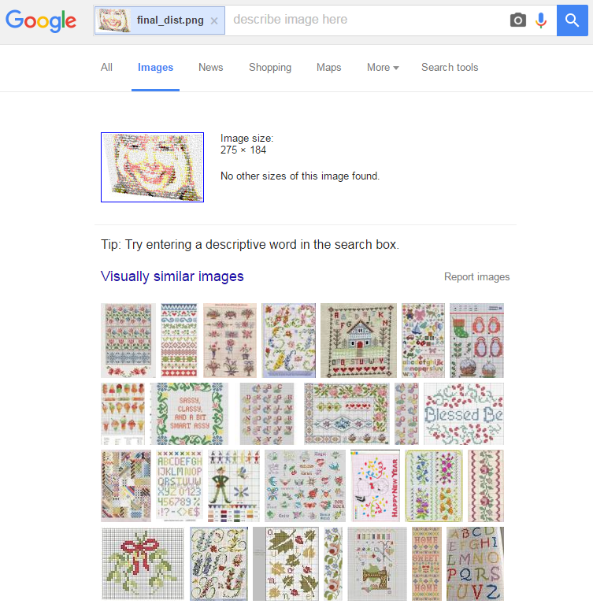
Stopping Reverse Image Search Attacks

Slide 40
CAPTCHA Challenge Ver 1.0
Images provide guarantee for stopping Emotion API
No guarantee for Reverse Image Search – filters not severe enough
Designed to test for usability – not for security (yet)
Experimenting with # of emotions

Slide 41
Sample Guesses for Ver. 1
Gathered responses from friends and other PhD students
Gathered over the course of two weeks
Instructed to match the emotion in the image to the emoji that most closely represents the emotion

Slide 42
Emotion/Guess Matrix – Run 1

Slide 43
Test Run 1 Results
When we showed images depicting neutral, users guessed neutral 96% of the time correctly…

Slide 44
Test Run 1 Results
73% of the time users clicked neutral in an image challenge, they were correct…

Slide 45
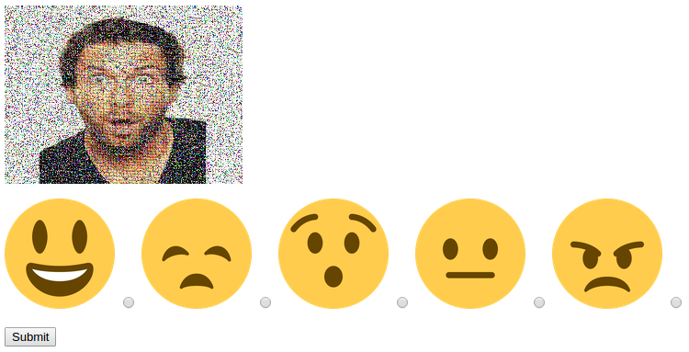
CAPTCHA Challenge Ver 2.0
Reduced set of emotions to simplify challenge
Designed to see if usability improved

Slide 46
Emotion/Guess Matrix – Run 2

Slide 47
Test Run 2 Results
When we showed images depicting neutral, users guessed neutral 94% of the time correctly…

Slide 48
Test Run 2 Results
83% of the time users clicked neutral in an image challenge, they were correct…

Slide 49
Analysis of Design Criteria
Usability
People can easily recognize faces and emotions they are expressing
Warping/distortions can prove too severe for humans to interpret emotion
Currently no options for blind users
Scalability
Emotion API provides way to automate emotional tagging
Scraping social media or #hashtags for new images
Robustness
Resistant to RIS and CV attacks
Variety in method of challenge expression (e.g. map opposite emotions (happy vs sad), match emoticon to emotion, select all faces expressing the following emotion etc.
Warping/Distortions can be reversed by image processing (no one way image processing functions)
Potential for specialized machine learning algos / neural networks to learn emotional patterns and conduct attacks on CAPTCHA (e.g. deep learning)

Slide 50
Limitations of Current Design
Image Scraper
“worse” images as you crawl deeper into results of a search term
Potential database attacks depending on image sources
Emotion API
The emotions ‘contempt’ and ‘disgust’ are experimental
Some faces may not be detected due to technical challenges, e.g. very large face angles (head-pose), large occlusion, etc.

Slide 51
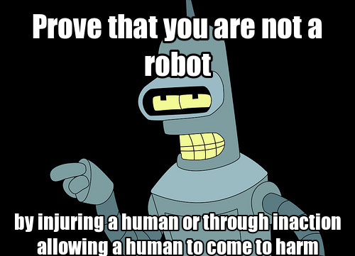
Limitations Cont.
Image Distortions
Usability issues
Reversibility issues

Slide 52
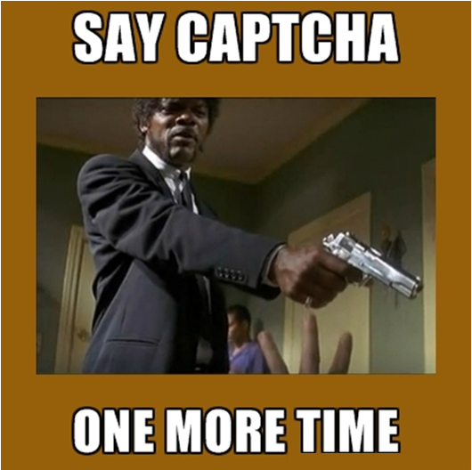
Thank You!
http://HackedExistence.com

Slide 53
Resources
https://www.microsoft.com/cognitive-services/en-us/emotion-api
http://cseweb.ucsd.edu/~mmotoyam/usec10-recaptchas.pdf
http://www.lancaster.ac.uk/staff/yanj2/ccs10.pdf
https://cdn.elie.net/publications/the-end-is-nigh-generic-solving-of-text-based-captchas.pdf
https://www.blackhat.com/docs/asia-16/materials/asia-16-Sivakorn-Im-Not-a-Human-Breaking-the-Google-reCAPTCHA-wp.pdf

